Slide 1
Introduction to Big Data

Slide 2
Big Data
Big data is:
large datasets
a term used to describe a collection of data that is huge in volume and yet growing exponentially with time
so large and complex that none of the traditional data management tools are able to store it or process it efficiently
Def: “Big Data” is data whose scale, diversity, and complexity require new architecture, techniques, algorithms, and analytics to manage it and extract value and hidden knowledge from it…

Slide 3
Characteristics of Big Data
Big data can be described by the following characteristics:
Generic Properties:
Volume
Variety
Velocity
Acquired Properties (after entering system)
Veracity
Value
Variability

Slide 4
5 V’s- Volume
The quantity of generated and stored data
The size of the data determines the value and potential insight, and whether it can be considered big data or not
The size of big data is usually larger than terabytes and petabytes

Slide 5
5 V’s- Velocity
The speed at which the data is generated and processed to meet the demands and challenges that lie in the path of growth and development
Big data is often available in real-time
Compared to small data, big data is produced more continually
Two kinds of velocity related to big data are the frequency of generation and the frequency of handling, recording, and publishing

Slide 6
5 V’s- Variety
The type and nature of the data
Structured
Semi-structured
Unstructured

Slide 7
5 V’s- Veracity
Veracity
It is the extended definition for big data, which refers to the data quality and the data value
The data quality of captured data can vary greatly, affecting the accurate analysis
Trustworthiness
Authenticity
Origin, Reputation
Availability
Accountability

Slide 8
5 V’s- Value
Value
The utility that can be extracted from the data
Correlations
Statistical
Events
Hypothetical

Slide 9
5 V’s- Variability
It refers to data whose value or other characteristics are shifting in relation to the context in which they are being generated
Variability can also refer to the inconsistent speed at which big data is loaded into your database

Slide 10
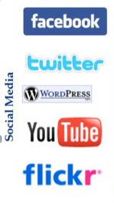
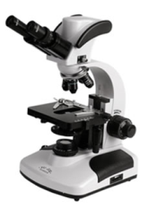
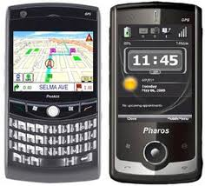
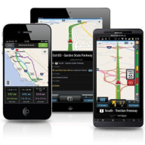
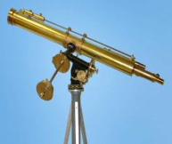

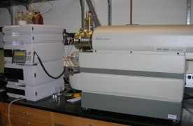
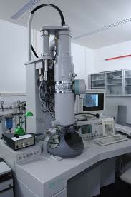
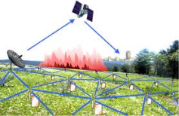

Who’s Generating Big Data
Mobile devices
(tracking all objects all the time)
Social media and networks
(all of us are generating data)
Scientific instruments
(collecting all sorts of data)
Sensor technology and networks
(measuring all kinds of data)
The progress and innovation is no longer hindered by the ability to collect data
But, by the ability to manage, analyze, summarize, visualize, and discover knowledge from the collected data in a timely manner and in a scalable fashion

Slide 11
Big Data Nature: Origin and Target
Big Data Origin
Science
Internet, Web
Industry
Business
Living Environment, Cities
Social media and networks
Healthcare
Telecom/Infrastructure
Big Data Target Use
Scientific discovery
New technologies
Manufacturing, processes, transport
Personal services, campaigns
Living environment support
Healthcare support
Social Networking

Slide 12
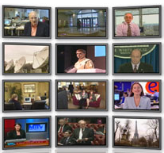
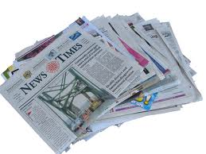
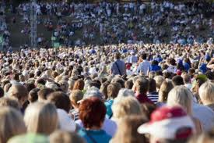

The Model Has Changed…
The Model of Generating/Consuming Data has Changed
Old Model: Few companies are generating data, all others are consuming data
New Model: all of us are generating data, and all of us are consuming data

Slide 13
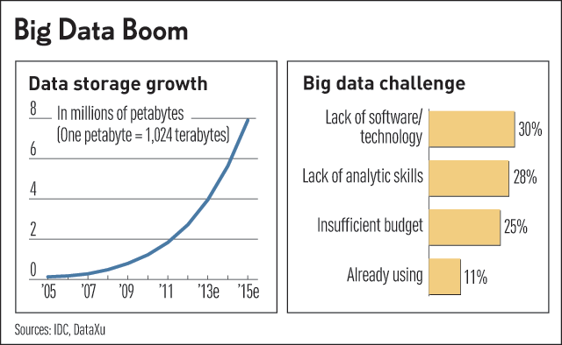
Challenges in Handling Big Data
The Bottleneck is in technology
New architecture, algorithms, techniques are needed
Also in technical skills
Experts in using the new technology and dealing with big data

Slide 14
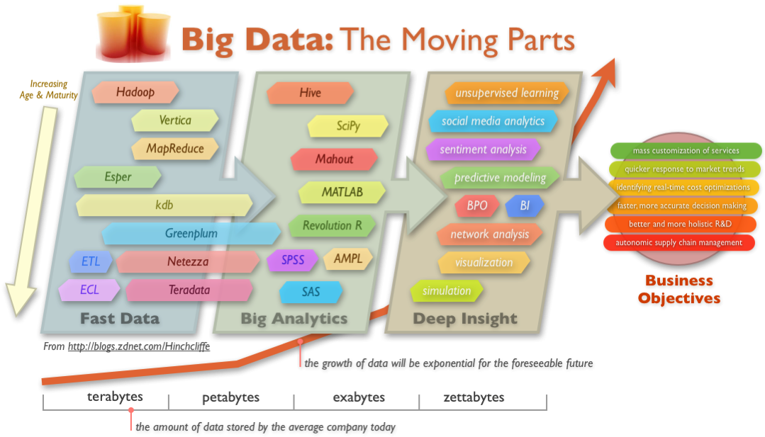
Big Data Technology

Slide 15
Benefits of Big Data Processing
Businesses can utilize outside intelligence while taking decisions
Improved customer service
Early identification of risk to the product/services, if any
Better operational efficiency

